Slide 1
Conditioning & Learning
Chapter 6

Slide 2
Conditioning & Learning
Cognitive Learning
  Understanding, knowing, anticipating, or making use of information-rich higher mental processes
    Written language
    Cognitive maps
    Latent learning
    Observational learning
    Discovery learning
Associative Learning
  Forming simple associations among various stimuli or responses
    Reinforcement
    Antecedents
    Consequences
    Classical conditioning
    Operant conditioning

Slide 3
Conditioning & Learning
Classical Conditioning
  Antecedents
    What happens BEFORE a response is made
  Automatic/unlearned
    Involuntary nervous system responses
      “fight or flight” reflex
  John Watson
    Little Albert experiment (http://youtu.be/Xt0ucxOrPQE)
      Learned Fears: page 211
      1. What was the unconditioned stimulus (US)?
      2. What was the unconditioned response (UR)?
      3. What was the neutral stimulus (NS)?
      4. What is now the conditioned stimulus (CS)?
      5. What is now the conditioned response (CR)?

Slide 4

Conditioning & Learning
Little Albert after thoughts
  What role did stimulus generalization play in his response? (p. 210)
  How could you use extinction or discrimination to help him? (pp. 210-211)
Personal application?
  Conditioned Emotional Response (CER)

Slide 5
Conditioning & Learning
Operant Conditioning
  Consequences
    What happens AFTER a response is made
  Active/learned
    “Operates” on the environment
    Reinforcement
      Positive reinforcement
      Negative reinforcement
    Punishment
      Positive punishment
      Negative punishment

Slide 6

Conditioning & Learning
Punishment
  Consequence = decreased behavior frequency
    Positive punishment
      Occurs when a behavior is followed by the addition of an unpleasant stimulus
        yelling or spanking a disruptive child
    Negative punishment
      Occurs when a behavior is followed by the removal of a pleasant stimulus
        taking away a child's toy following an undesired behavior
Reinforcement
  Consequence = increased behavior frequency
    Positive reinforcement
      Occurs when a behavior is followed by the addition of a pleasant stimulus
        receiving a token for cleaning a room
    Negative reinforcement
      Occurs when a behavior is followed by the removal of an unpleasant stimulus
        rolling up the car window when it begins to rain
Using Punishment Wisely – 7 Tips (pp. 227-228)

Slide 7
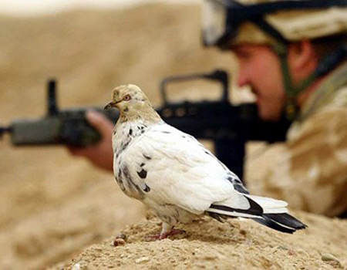
Conditioning & Learning
Primary reinforcers
  Food
  Water
  Sex
  Pigeon Guided Missiles
  http://www.military.com/video/operations-and-strategy/second-world-war/project-orcon-pidgeon-guided-missile/897399315001/

Slide 8
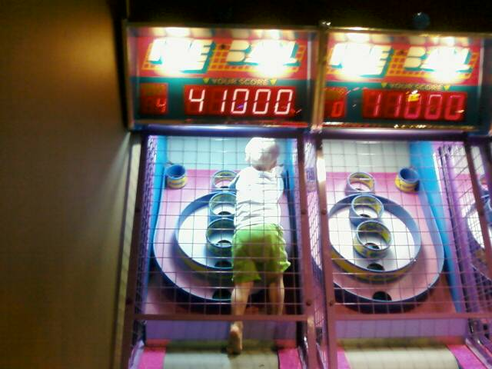
Conditioning & Learning
Secondary reinforcers
  Tokens
  Social
Response Chaining
Behavioral Shaping

